Slide 1

A Recommendation System for Book Lovers
Because reading is fun… damental

Slide 2
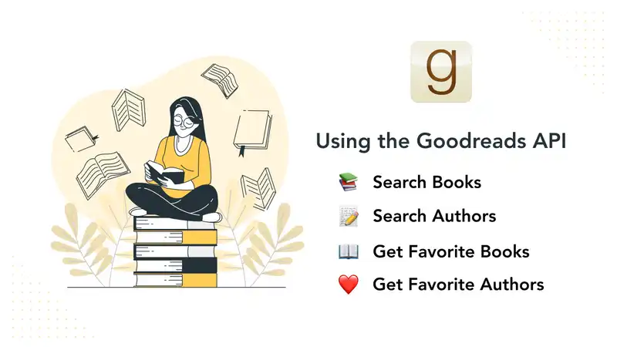


Dataset and preprocessing (EDA)
Where to find the data?

Slide 3
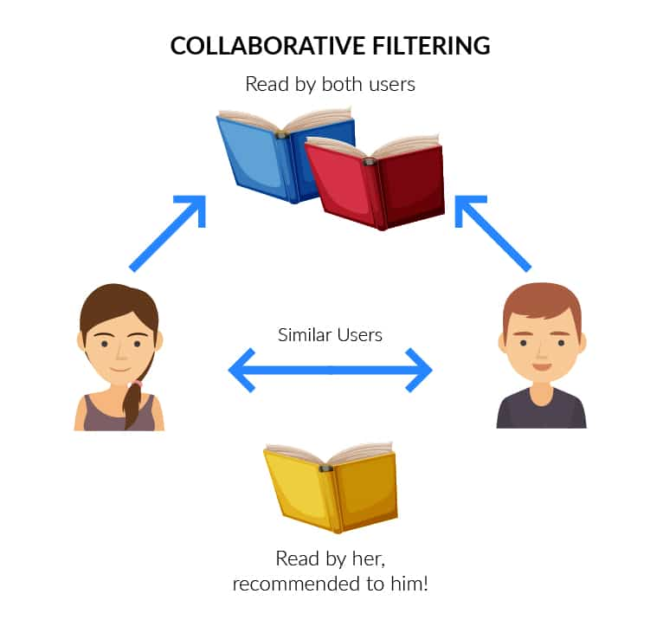
2. Building the model
Recommendation system

Slide 4
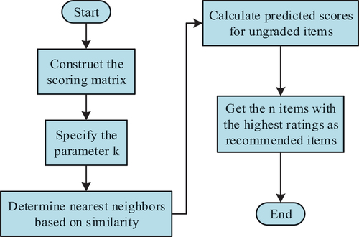
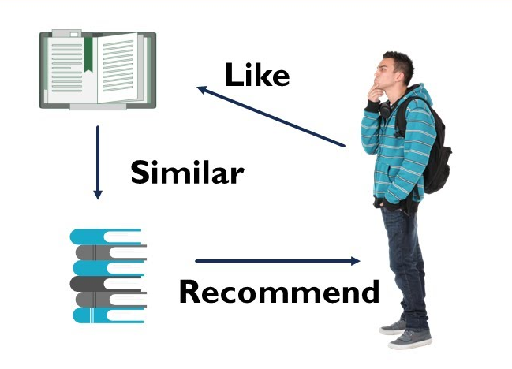
3. How does it work?

Slide 5
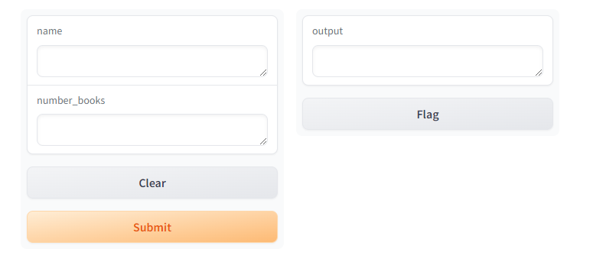
3. User Interaction with the model
Gradio Interface + A little of web scrapping

Slide 6
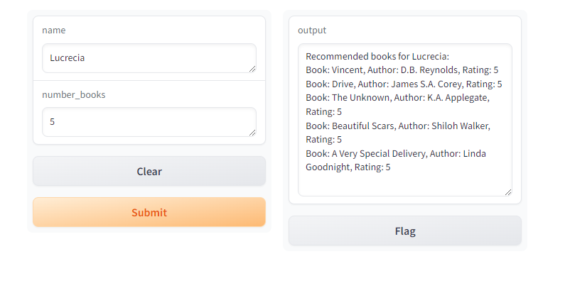
Books for Lucrecia

Slide 7
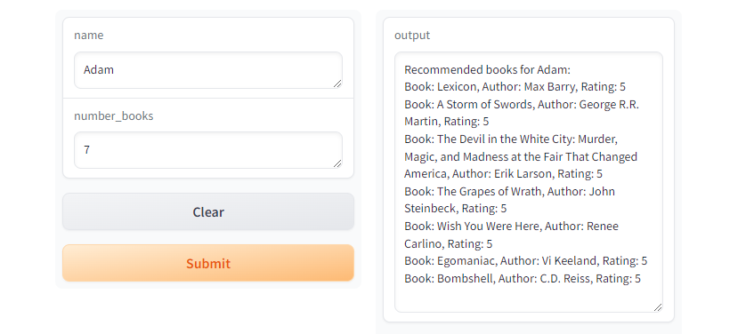
Books for Adam

Slide 8

CONCLUSION
THANK YOU!!!

